Slide 1

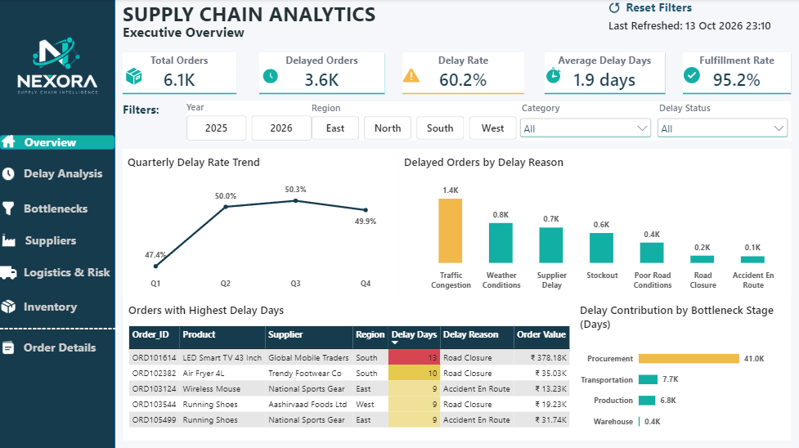
PROJECT PRESENTATION
Supply Chain Delay Analysis
An Interactive Power BI Dashboard
Prepared by Divyaa Shri B
Company (fictional) Nexora Supply Chain Intelligence
Institute NoviTech R&D Pvt Ltd
October 2026
Power BI · Python · DAX · Excel
Notes:
Introduce the project: an end-to-end supply chain delay analysis for a fictional Indian e-commerce company, Nexora, delivered as a seven-page Power BI dashboard.

Slide 2





Problem statement
Customers are promised delivery dates, yet teams cannot see where or why orders slip.
Fragmented data
Order, inventory, transport and vendor data sit in separate systems.
CORE NEED
A unified, interactive analytical solution that consolidates supply chain data, pinpoints where and why delays occur, and lets stakeholders drill from an executive view to individual orders.
Limited visibility
Static, delayed reports give no view of how performance changes.
Unclear root causes
Supplier, transport, warehouse and demand delays are hard to separate.
No multi-angle analysis
Delays cannot be cut by region, supplier, category or period.
Reactive decisions
Problems surface only after the customer is affected.
Notes:
Five gaps in today's reporting. Together they mean delays are found reactively. The core need is one unified, drillable view.

Slide 3







Objective
Primary objective
Build an interactive Power BI dashboard on a unified data model that gives clear visibility into delivery performance, so the organisation can find bottlenecks, cut delays and improve customer satisfaction.
Business questions the dashboard answers
How many orders are delayed, and how severe?
Which supply chain stage causes the most delay?
Which suppliers and regions contribute most?
Page: Executive Overview, Delay Analysis
Page: Bottleneck Analysis
Page: Supplier & Procurement, Delay Analysis
How do weather, traffic and roads affect delivery?
Do stockouts and inventory affect performance?
Which individual orders need attention?
Page: Logistics & Risk Analysis
Page: Inventory & Fulfillment
Page: Order Details
Notes:
Nine specific objectives roll up into one primary objective. The six business questions map each to a dashboard page.

Slide 4





Business understanding
DOMAIN
SECTOR
BUSINESS TYPE
PRIMARY FOCUS
FUNCTION
Supply Chain & Logistics
Operations
Product-based organisation
Operational efficiency & inventory
Procurement, warehousing, logistics
SUPPLY CHAIN JOURNEY
01
Procurement
02
Production
03
Warehouse
04
Transportation
05
Delivery
Business problem
Supply chain delays are hurting delivery performance and customer satisfaction. Late products, declining performance and a few suppliers or regions that keep slipping.
Analytical problem
No clear view of where and why delays occur, so bottlenecks are hard to find and corrective action comes late.
Business objective Identify delay patterns and bottlenecks, understand their likely causes, and support timely corrective action.
Notes:
Phase 1 framing. Symptoms: late deliveries, repeat-offender suppliers and regions, delays at different stages, and static reports.

Slide 5
Methodology: six phases, raw data to insight
1
2
3
4
5
6
Data collection
Data understanding
Cleaning & transformation
Feature engineering
Data modelling
Dashboard & insights
Claude.ai
Python, Pandas
Python, Pandas
Python, Pandas
Power BI, DAX
Power BI
5 CSV files: 1 fact, 4 dimension tables
List of data quality issues
Clean fact table, 10,470 rows
6 new columns, 45-column fact table
Star schema, 35 DAX measures
7-page dashboard, recommendations
Technology stack
Python + Pandas
cleaning, features
Jupyter
documented workflow
Excel
5-sheet data source
Power BI + DAX
model, 7 pages
Claude.ai
synthetic dataset
Notes:
Each phase hands an output to the next. Cleaning is fully scripted and reproducible in a Jupyter notebook; raw files are never modified.

Slide 6
Data collection and understanding
Synthetic data for a fictional Indian e-commerce company, modelled on marketplaces like Amazon, Flipkart, Meesho and Myntra.
Table | Type | Rows | Content
Transactions | Fact | 10,536 | Order lines: quantities, costs, dates, delays, stages, weather, inventory
Products | Dimension | 20 | 9 categories, priority, lead time
Supplier | Dimension | 15 | 11 manufacturers, 4 distributors, rating 3.4 to 4.5
Location | Dimension | 15 | 15 warehouses in 4 regions
Transportation | Dimension | 15 | 11 road, 2 air, 2 rail routes
8 data quality issues found in the raw fact table
Missing values in 12+ columns
36 duplicate transactions
Mixed upper/lower case text
Unit cost stored as text (Rs.)
Five different date formats
Placeholder costs (-100, 999999)
30 negative quantities
40 over-deliveries
10,470
6,078
45
clean rows
unique orders
analysis columns
Notes:
Dimension tables were clean; the fact table deliberately had realistic problems so cleaning reflects real analytical work. Data covers 5 Jan 2025 to 17 Sep 2026.

Slide 7
Cleaning and feature engineering in Python
10,536
-36
-30
10,470
Six engineered features
raw rows
duplicate IDs
negative qty
clean rows
Primary_Bottleneck_Stage
slowest stage per order
Cleaning steps
Bottleneck_Days
days lost in that stage
Text trimmed and standardised; flags mapped to Yes / No
Unit cost converted to numbers; placeholders replaced by median
Five date formats parsed into true dates
Missing values treated by cause, not one blanket rule
In-transit and cancelled orders kept blank on purpose
All validation checks re-run and passed
Promised_Lead_Time_Days
promise minus order date
Order_Fulfillment_Gap
ordered minus delivered
Undelivered_Order_Value
gap in rupees
Delay_Percentage_of_Promised
delay vs promised time
Result: procurement is the slowest stage for 70.3% of transaction lines.
Notes:
Every step is scripted in a nine-step Jupyter notebook. Bottleneck split: Procurement 70.3%, Transportation 15.0%, Production 13.3%, Warehouse 1.4%. Undelivered value is about Rs 4.57 crore, 4.3% of Rs 107.1 crore total order value.

Slide 8
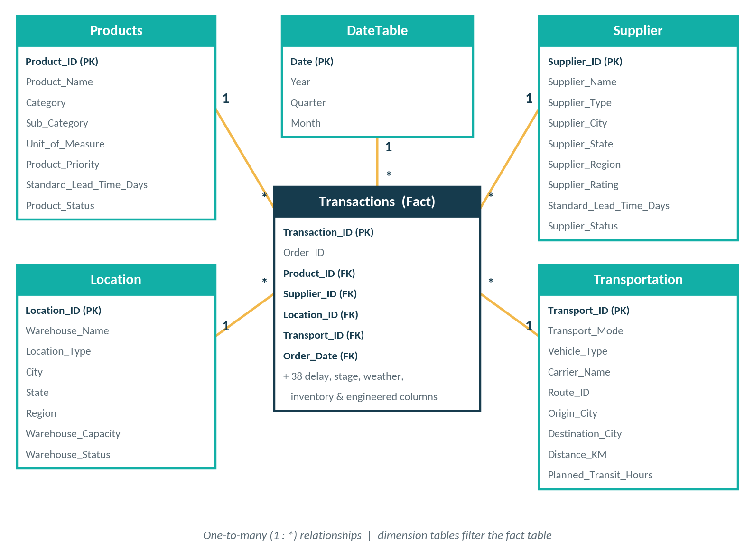
Data modelling: star schema and DAX
35 reusable DAX measures
10
Volume & delay KPIs
4
Bottleneck
4
Supplier & procurement
5
Logistics & risk
5
Inventory & fulfilment
7
Display & helper
Delay Rate =
DIVIDE( [Delayed Orders],
[Completed Orders] )
Orders = distinct Order_ID (6.1K); transactions = order lines (10,470).
One-to-many relationships; dimension tables filter the fact table, so every slicer cross-filters every visual.
Notes:
Fact table plus four dimensions plus a DateTable. Central measures keep one definition of every KPI across all pages.

Slide 9


Dashboard development: a guided journey
Big picture first, then where and why delays happen, then which orders to act on.
1
2
3
4
Executive Overview
Delay Analysis
Bottleneck Analysis
Supplier & Procurement
KPIs, delay drivers, worst orders
Trend, severity, region, category
Days lost by stage and region
Supplier delay rate, lead times
5
6
7
On every page
Left navigation panel
Year and Region slicers
Reset Filters button
Last Refreshed stamp
Logistics & Risk
Inventory & Fulfillment
Order Details
Traffic, weather, road condition
Stockouts, fulfilment rate
Drill-down to single orders
Notes:
Design: navy and teal base, amber accent highlights the leading contributor in each chart. Each page has a KPI strip, a filter strip and two to four visuals.

Slide 10
Executive Overview
What leadership sees at a glance
Five KPI cards: orders, delayed orders, delay rate, average delay, fulfilment rate
Delay reasons, with the top reason highlighted
Delay days by bottleneck stage
Worst orders, colour-coded yellow to red
3.6K delayed orders, running 1.9 days late on average
6.1K
60.2%
95.2%
orders
delay rate
fulfilled
Notes:
Landing page answers: how are we doing? 6.1K orders, 3.6K delayed (60.2%), 1.9 days average delay, 95.2% fulfilment.

Slide 11
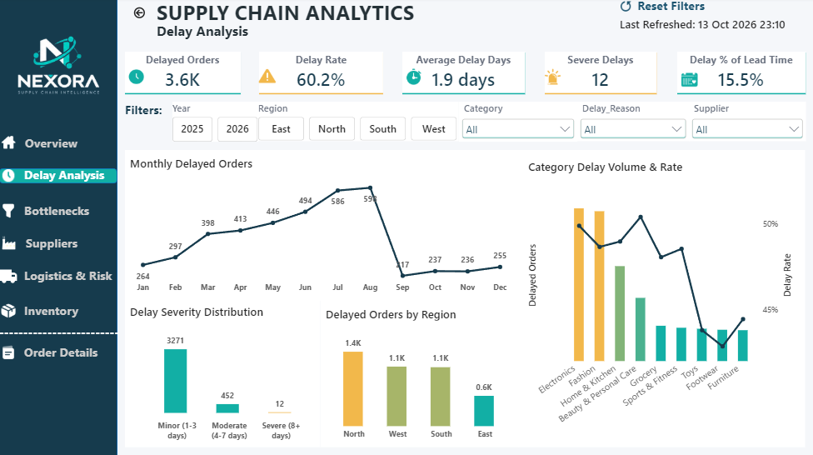
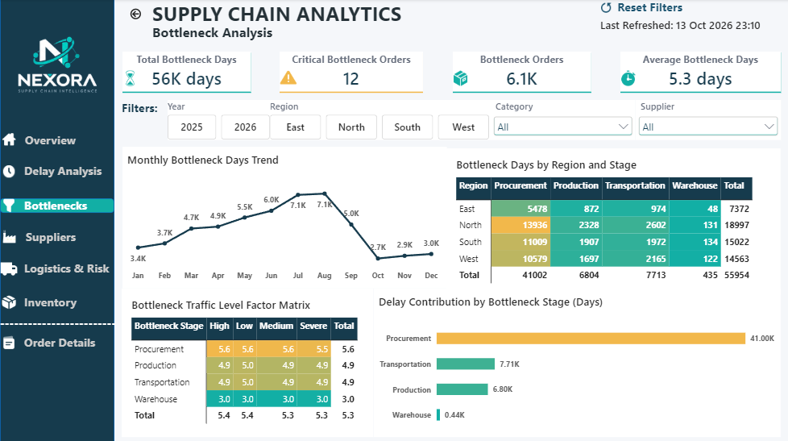
Delay and bottleneck analysis
Delay Analysis
Bottleneck Analysis
Minor 3,271, moderate 452, severe 12
Monthly drop after August reflects data ending 17 Sep 2026, not improvement
56K bottleneck days; 41.0K sit in procurement
Heat-map matrices by region, stage and traffic level
Notes:
Walk through each page: purpose, the key visual, and what it reveals.

Slide 12
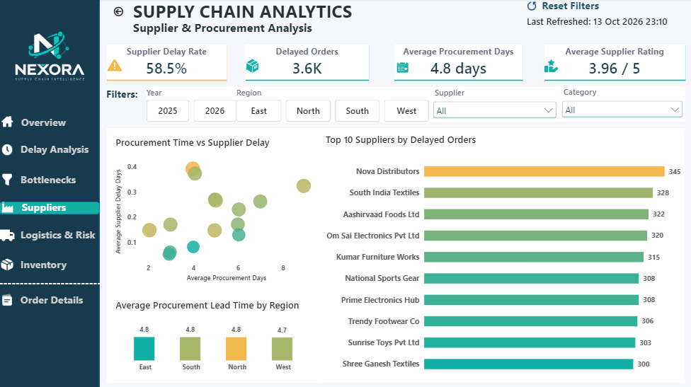
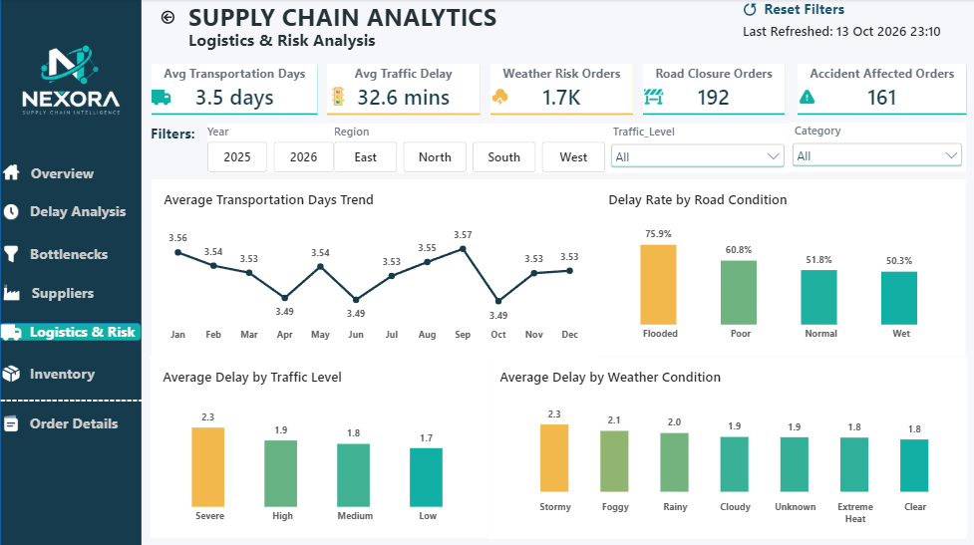
Supplier and logistics analysis
Supplier & Procurement
Logistics & Risk
Supplier delay rate 58.5%, average rating 3.96 / 5
Top 10 suppliers sit in a narrow 300 to 345 delayed-order band
Delay rate by road condition, traffic and weather
Flooded roads: 75.9%, versus 51.8% on normal roads
Notes:
Walk through each page: purpose, the key visual, and what it reveals.

Slide 13
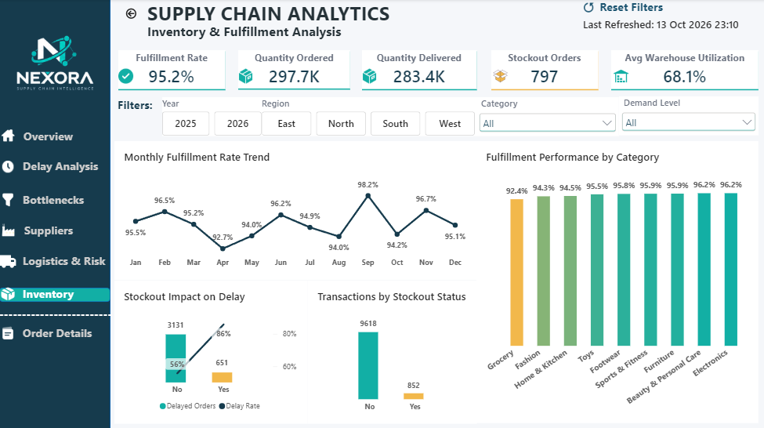
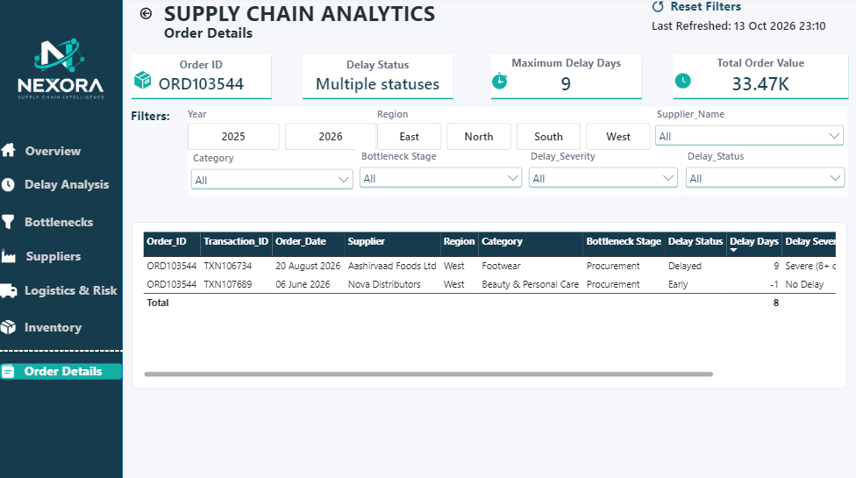
Inventory analysis and order drill-down
Inventory & Fulfillment
Order Details
Delay rate 86% with a stockout, 56% without
Warehouse utilisation averages 68.1%
Drill down to individual orders and transaction lines
Extra slicers: bottleneck stage, severity, delay status
Notes:
Walk through each page: purpose, the key visual, and what it reveals.

Slide 14
Key findings: four numbers that matter
60.2%
of orders are delayed
3.6K of 6.1K orders, 1.9 days late on average
73%
of bottleneck days are procurement
41.0K of 56.0K days lost
+30 pts
delay rate when a stockout occurs
86% with a stockout vs 56% without
75.9%
delay rate on flooded roads
vs 51.8% on normal roads
Context Delays are frequent but short (3,271 of 3,735 delayed orders were 1 to 3 days), and 95.2% of ordered units were delivered. The problem is timeliness, not volume.
Notes:
Delayed orders by severity: 3,271 minor + 452 moderate + 12 severe = 3,735. Stockout difference is 86% vs 56%.

Slide 15
Where delays originate
Procurement dominates
Orders slowed by procurement lose 5.6 days on average, vs 4.9 for production and transport.
North region is hardest hit
19.0K bottleneck days (34%), of which 13.9K are procurement.
It is an internal process issue
Average bottleneck days barely move with traffic level (5.3 to 5.4).
Delays are systemic
Top 10 suppliers range only 300 to 345 delayed orders; regional procurement time is 4.7 to 4.8 days.
Notes:
Two complementary views: recorded delay reasons put traffic congestion first (1.4K), then weather (0.8K), supplier delay (0.7K), stockout (0.6K). Time by stage puts procurement first. External events trigger visible delays; long procurement consumes the buffer that would absorb them.

Slide 16
External risk and inventory effects
Storms add the longest delay (2.3 days vs 1.8 in clear weather); severe traffic adds a similar premium (2.3 vs 1.7).
797 orders hit a stockout while warehouse utilisation averages 68.1%: a replenishment issue, not a space issue.
Notes:
Flooded roads add about 24 points to the delay rate. Stockouts add about 30 points. External risk events are limited in volume: 1.7K weather-risk orders, 192 road closures, 161 accident-affected orders.

Slide 17






Recommended actions
1
2
3
Shorten procurement time
Cut stockouts
Plan for weather, road and traffic
Lead-time agreements, earlier PO triggers, escalation path; start with North.
Demand-based reorder points and safety stock; Grocery first.
Buffer flood-prone routes, reroute in storms, dispatch off-peak.
4
5
6
Run a supplier programme
Set realistic promise dates
Watch severe cases
Common service levels and scorecards for all suppliers, not just the weakest.
Delays average 15.5% of lead time; calibrate by region and category.
Track the 12 severe delays and critical bottleneck orders in Order Details.
Notes:
Ordered by expected impact: procurement carries 73% of bottleneck days; stockouts add about 30 points to the delay rate.

Slide 18



Conclusion
What was built
What it shows
Why it matters
A complete pipeline: a 10,000+ row dataset, Python cleaning, 6 engineered features, a star schema with 35 DAX measures and a 7-page dashboard.
60.2% of orders are delayed; procurement drives ~73% of bottleneck days; stockouts add ~30 points; flooded roads reach 75.9%.
Fragmented data becomes actionable insight, moving supply chain management from reactive reporting to evidence-based decisions.
Notes:
The same approach can be applied to live organisational data.

Slide 19








Future scope
Predictive delay model
Real-time integration
Cost-of-delay page
Supplier risk score
Classify orders likely to be late before they ship.
Live feeds, incremental refresh and threshold alerts.
Surface the ~Rs 4.57 crore undelivered order value.
Combine rating, delay rate and procurement time.
Carrier optimisation
What-if scenarios
Root-cause visuals
Role-based and mobile
Compare carriers, modes and distances to plan.
Simulate fewer procurement days or stockouts.
Key Influencers and Decomposition Tree.
Row-level security by region, mobile layouts.
Notes:
Several of these reuse fields already engineered in the model, such as Undelivered_Order_Value.

Slide 20
Thank you
Questions and discussion
Divyaa Shri B | NoviTech R&D Pvt Ltd

